Slide 1
Mountain Bike Suspension 20FB14
Erik Abraham, Suliman Alsinan, Austin Coyne, Jacob Cryder, Dylan Klemp, Tyson Spencer

Slide 2
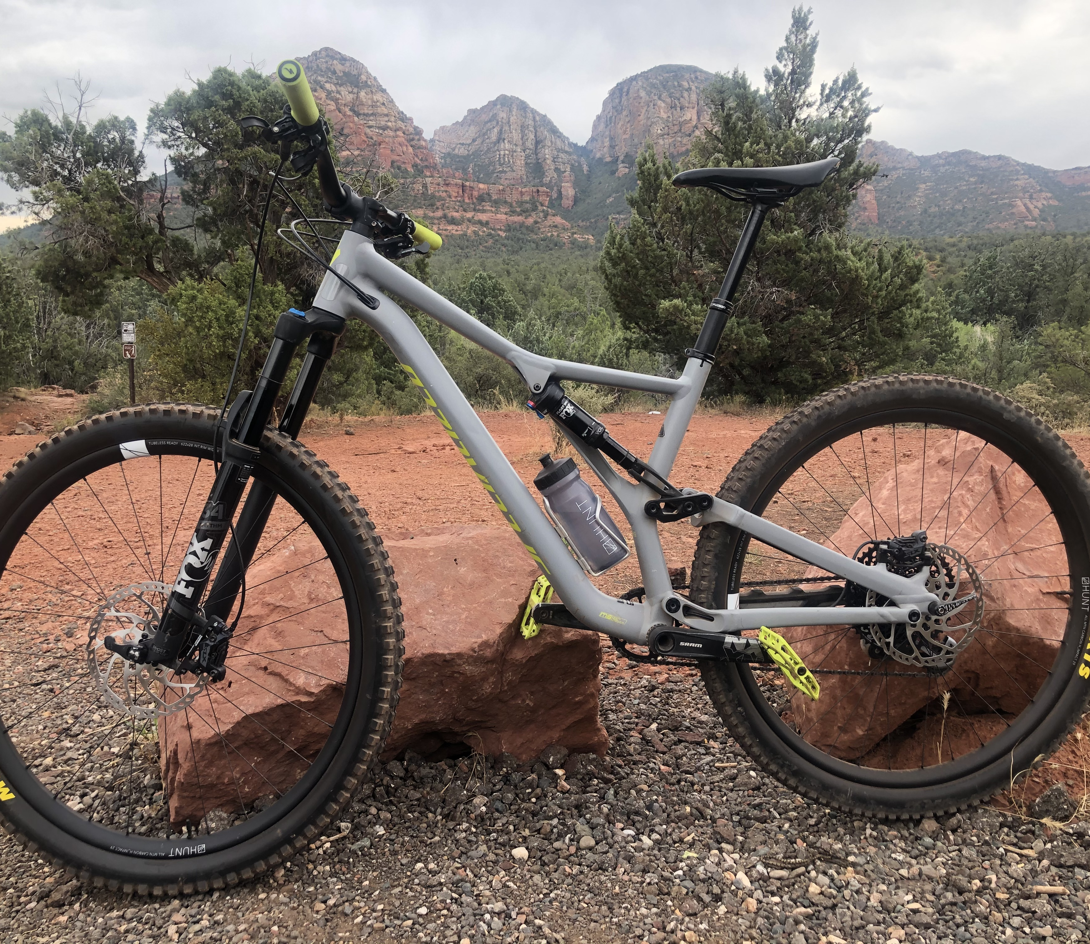
Background
Mountain bikes are widely used by both professional and casual riders, which results in knowledge gaps concerning the mechanics of bikes and how to optimize their performance for various terrain types. This prevents the casual riders from adjusting their own suspension, causing them to seek help at local bike shops. Suspension settings should be continuously adjusted based on the trail the rider is currently on, leading the team to arrive at the idea for this project.
Notes:
Background/Current State-of-the-art
-What are existing approaches to the problem your project addresses?
-----Describe how you found this information and provide references to it
-Are there existing designs that are intended to address the problem of your project?
-----Can you list some shortcomings of those that you intend to fix?
-What are some ideas from completely different applications that you are considering for use in your project?
-----Are any of these bio-inspired?

Slide 3
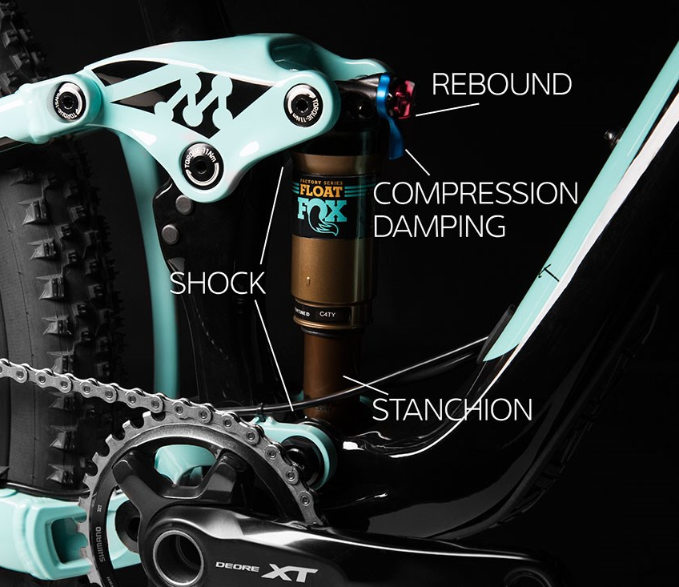
Project Description
This project seeks to develop a mathematical model which optimizes damping and spring rates for various terrain types on specific full suspension mountain bike geometries.
The team will first acquire one or more modern full suspension mountain bikes and develop remote adjustment systems for the front and rear air springs.
The team will then test the suspensions on various local trails, using measured data to validate the mathematical model previously developed.
If successful, the resulting mathematical model should help amateur mountain bikers who own the bike(s) the team analyzed optimize their suspensions for any given trail difficulty.
Hopefully, the model may be expanded to apply to a wider range of full suspension mountain bike geometries.
[1]
Notes:
Provide a brief but meaningful review / description of the project
What problem does this project aim to solve?
What technological, social, environmental or other impact would your project have if successful?

Slide 4
Problem Statement
Mountain bike suspension lacks the capabilities to quickly and easily adjust for different terrain on the fly and needs to have a tuning option to allow for more comprehensive system. Mountain bike suspension can also be adjusted but can sometimes be difficult to understand the changes for the average consumer; so the team needs to create an easier way to help even beginner bikes be able to alter their suspension settings.

Slide 5
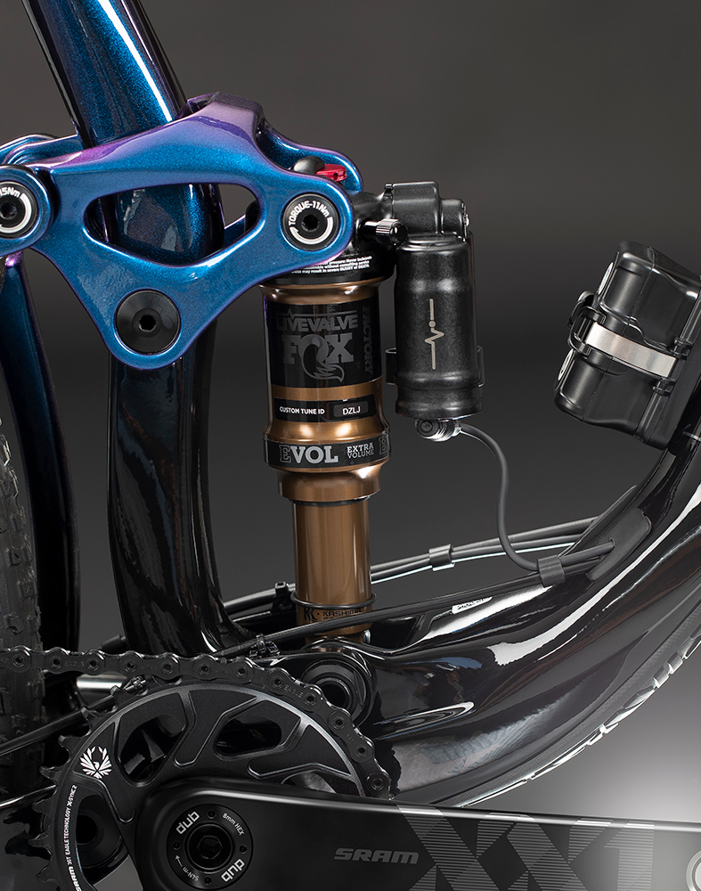
State of the Art
Similar Products on the market:
Specialized Brain: Uses a valve to regulate the amount of oil flow in the shock, staying firm when pedaling and compressing when going over bumps [2].
Fox Live Valve: Battery powered device that uses an app to adjust for terrain and can used with different bike brands [3].
Quarq Shock Wiz: Uses a phone app to regulate air pressure in the shocks and suggests tunings for spring rate, rebound, etc [4].
https://www.ridefox.com/content.php?c=livevalve-bike

Slide 6
Customer Requirements
Base research off current mathematical models
Extensive research on the suspension system and bike frame
Ensure that an average customer can use the design
Incorporate both a solid works model and MATLAB code
Validation testing (field work modeling)
Notes:
What did the customer require of this project?
•What were priority requests?
•Which ones were “must-have?”
•If there were any that were “nice to have” or optional, what were they?

Slide 7
Engineering Requirements
Spring rate and damping rate are critically damped for all given terrains
Validate mathematical model with other models
Compatible with test bike (Yes or no)
Minimize Weight Addition to Bike (kg)
Compact design to fit on handlebar of bike (cm)
Ensure durability to withstand impacts and weather on trails (hours)
Notes:
-How did you map the customer requirements to engineering requirements?
-Describe how all of the engineering requirements are clearly quantified.

Slide 8
Project Sponsors
Gore
Gore is the primary sponsor for this project. Brandon Lurie, a Gore engineer, is the team's primary client as well. Gore will be providing funds and an expert to consult during engineering analysis.
Northern Arizona University
NAU is the secondary sponsor of this project, with the capstone team operating through NAU’s engineering department.
Potential Sponsor
We will be reaching out to multiple mountain bike companies explaining our project proposal and goals. Ideally, a bike company will be able to sponsor the team via supplying a mountain bike to utilize for testing.
Notes:
Who is sponsoring the project and why it is important?

Slide 9
Sources Cited
[1] Liv. https://www.liv-cycling.com/global/campaigns/how-to-set-up-mountain-bike-suspension/20654. Accessed: 18 September 2020
[2] Specialized. The All-New Brain. https://www.specialized.com/us/en/stories/brain-technology. Accessed: 18 September 2020
[3] Fox. Live Valve. https://www.ridefox.com/content.php?c=livevalve-bike. Accessed: 18 September 2020
[4] SRAM. Quarg Shockwiz. https://www.sram.com/en/quarq/series/shockwiz. Accessed: 18 September 2020

